Slide 1
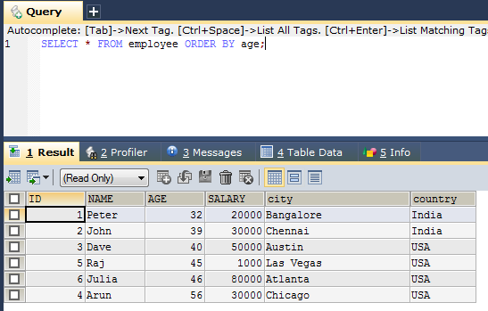
SQL ORDER BY Keyword
The ORDER BY keyword is used to sort the result-set in ascending or descending order.
The ORDER BY keyword sorts the records in ascending order by default.
To sort the records in descending order, use the DESC keyword.
Selects all employee from the "Employee " table, sorted by the “age" column
SELECT * FROM employee ORDER BY age;
SELECT column1, column2, ... FROM table_name ORDER BY column1, column2, ... ASC|DESC;

Slide 2
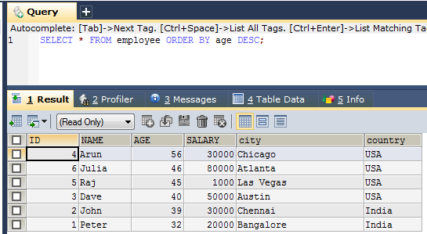
SQL ORDER BY Keyword
Selects all employee from the "Employee " table, sorted DESCENDING by the “age" column
SELECT * FROM employee ORDER BY age DESC;

Slide 3
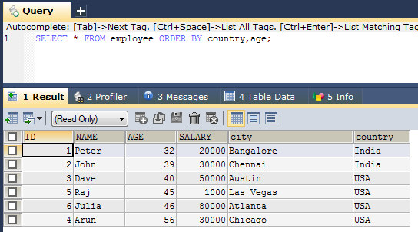
SQL ORDER BY Keyword
Selects all employee from the "employee" table, sorted by the "Country" and the “age" column. This means that it orders by Country, but if some rows have the same Country, it orders them by age.
SELECT * FROM employee ORDER BY country,age;

Slide 4
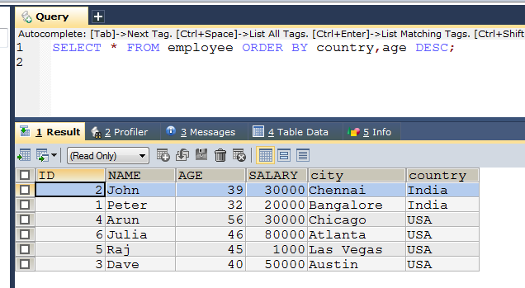
SQL ORDER BY Keyword
Selects all employee from the "employee" table, sorted by the "Country" and the “age" column in descending order. This means that it orders by Country in descending order, but if some rows have the same Country, it orders them by age in descending order.
SELECT * FROM employee ORDER BY country,age DESC;

Slide 5
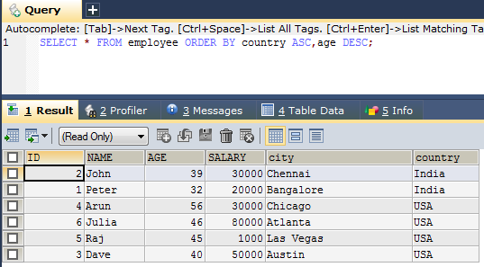
SQL ORDER BY Keyword
Selects all employee from the "employee" table, sorted ascending by the "Country“ and descending by the “age" column. This means that it orders by Country in Asc order, but if some rows have the same Country, it orders them by age in desc order.
SELECT * FROM employee ORDER BY country ASC,age DESC;

